Slide 1
Airline Passenger Satisfaction
Mudit Aggrawal , Hong Fei Jin , Jenny Yao , Pedro Jose Trujillo Mejia​, Himanshu Mayank ​, Nilanjana Raghu ​, Ying Fang Liang

Slide 2
Our Team
Business Analysts:
Hong Fei Jin – jinh1004
Pedro Trujillo – PedroJoseTrujilloMejia
Data Scientist:
Himanshu Mayank – hm6650
Data Engineer:
Mudit Aggarwal Muditmoody
Ying-Fang Liang yingfangliang
Nilanjana R Raghu – Nilanjana-Raghu
Jenny Yao – Jiaying-Yao

Slide 3
Introduction

Slide 4

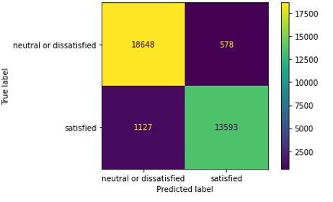
Review
What factors affect customer satisfaction the most in the context of airline passengers?
103,904 Observations from an airline passenger satisfaction survey
23 Variables including Satisfaction, Flight distance, Type of Travel
XGBoost Classification Model with an accuracy of 96% using the best parameters

Slide 5
Business Use Cases
PLACEHOLDER FOR UCs

Slide 6
Docker Stuff?
PLACEHOLDER FOR UCs

Slide 7
User Interface
PLACEHOLDER FOR Interface

Slide 8
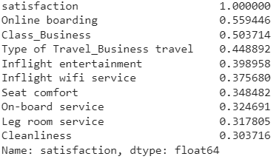
Target Leakage
Occurs when predictors include data that is not available at the time of making the prediction (after the flight in our context)
“Online boarding”, “Inflight Wifi Service”, “Baggage Handling”
might be leaky predictors
With
Without
95.3%
92.8%
CV Accuracy
CV Accuracy
These predictors are not greatly influencing model accuracy

Slide 9
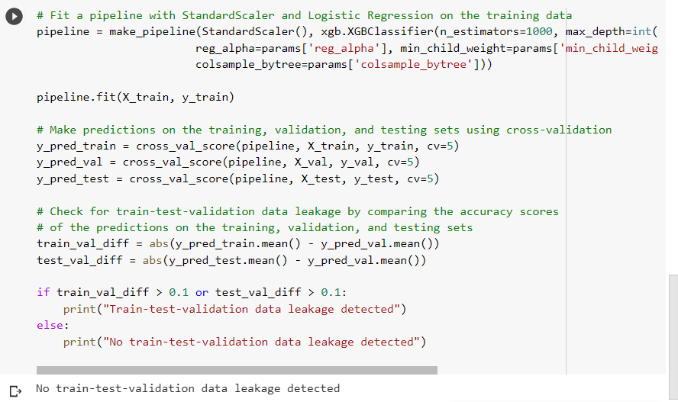
Train-Test Leakage
When data from validation / test sets are inadvertently used in training the model, leading to overly optimistic performance estimates & poor generalization performance
Code trains an XGBoost classification model (had the best accuracy amongst tested models)
Then uses cross-validation to make predictions on training, validation, and testing sets
Pipeline trained & validated without any evidence of data leakage

Slide 10
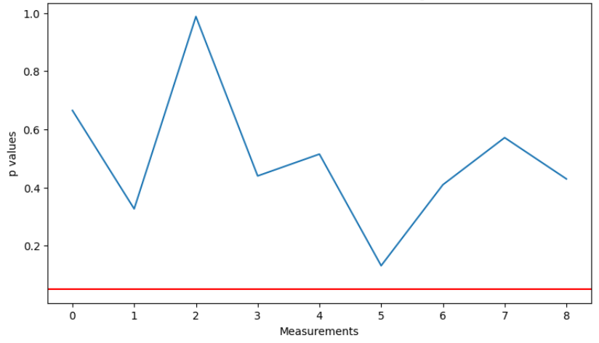
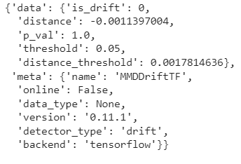
Data Drift
Check the quality of incoming data with respect to existing data
Samples of data are used to monitor changes in data distribution
Approaches:
Statistical Methods – Kolmogorov-Smirnov (K-S) Test (Null values, outliers, data dist)
ML Models – TensorFlow Keras layers, ClassifierDrift
Statistical Control of Outliers in Flight Distance
One method to solve the issue would be by increasing the weight of more recent points
Data does not have any drift

Slide 11
AutoML & Optimization

Slide 12
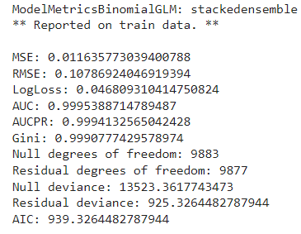
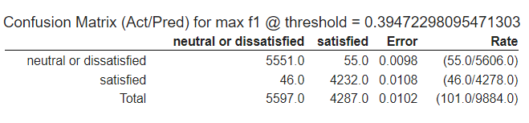
H2O AutoML
TEMPORARY
Models with top 3 accuracy
Stacked Ensemble
Gradient Boosting Machine
XGBoost
H2O AutoML offers several features and benefits, including:
Automated model selection, tuning, and deployment for highly accurate predictive models.
Time-saving workflow by automating time-consuming tasks, such as feature engineering and hyperparameter tuning.
Intuitive interface for ease of use.
Advanced algorithms that ensure accuracy and reliability, even with complex datasets.
Open-source and free to use.
error = h2o_compare['actual'] - h2o_compare['predicted']

Slide 13
TPOT AutoML
TEMPORARY
TPOT is an AutoML framework that optimize ML pipeline using genetic programming
TPOT can automate ML processes including feature selection, feature construction, model selection, parameter optimization and so on.
For the learning and exploration purpose, we tried TPOT on fully prepared dataset to see how it perform model selection and parameter tuning; and on the original dataset with dummyfied variables to observe its feature manipulation capability.
There are chances that TPOT use imputer for fully processed data, however, TPOT always deploys a simple imputer for unprocessed input data.
Best Ensembled Model on Fully Processed Dataset:
Imputer: Median
Estimator 1: BernoulliNB
Estimator 2: XGBClassifier
Estimator 3: BernoulliNB
Final Estimator: MLPClassifier
Validation Score: 95.93
Best Model on the Original Dataset:
Imputer: Median
Model: ExtraTreesClassifier
Validation Score: 96.20

Slide 14
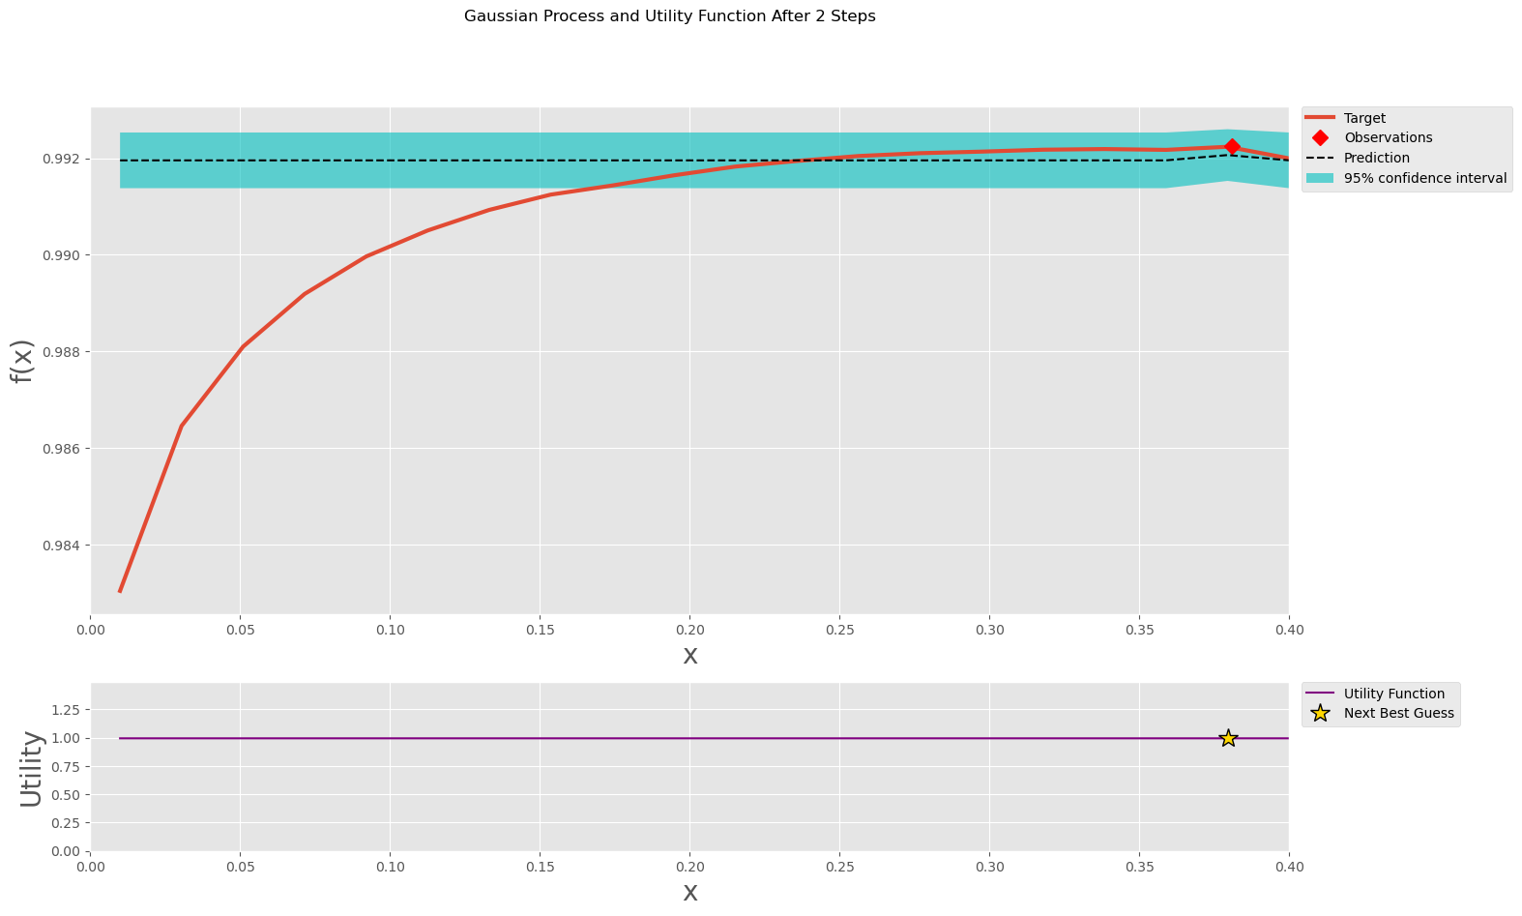
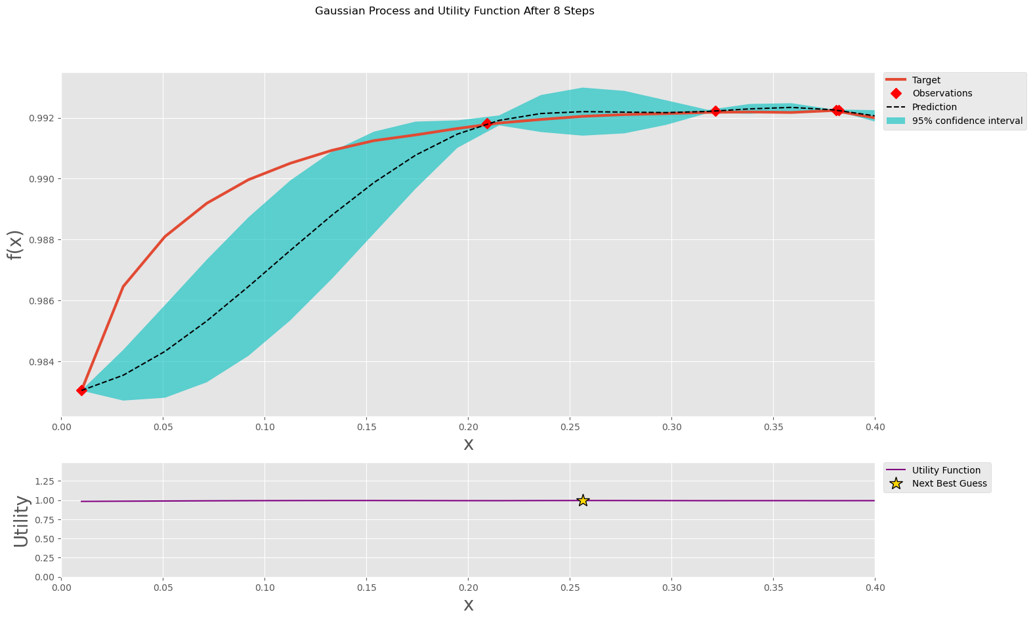
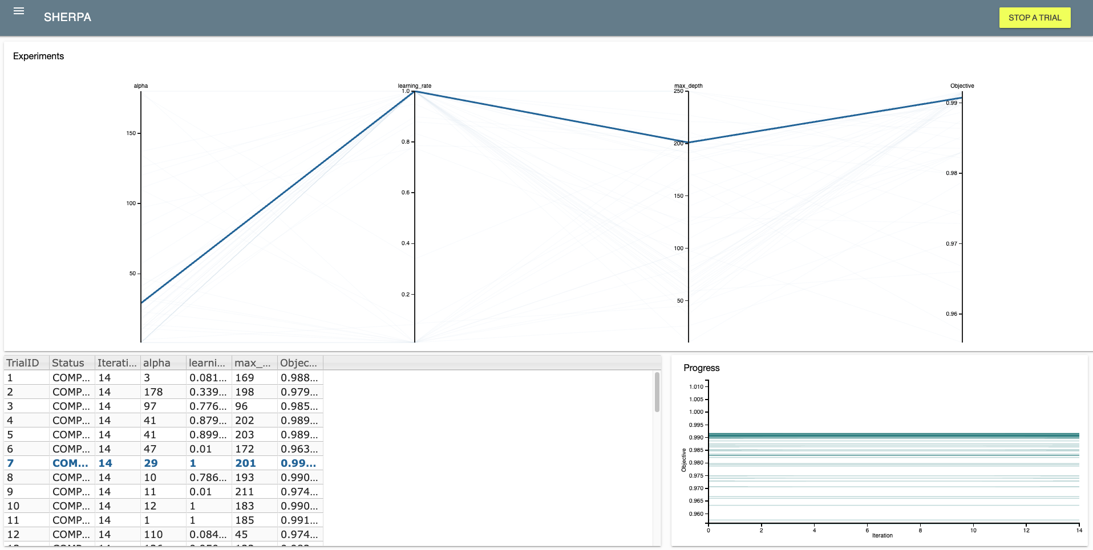
Hyperparameter Optimization
bayes_opt: Set parameter bounds, define the target function (cross-validation values), and run optimization with .maximize()
SHERPA: Library that provides various hyperparameter tuning algorithms including Bayesian, Asynchronous Successive Halving (ASHA), and Population-based methods. We can also define parameter types

Slide 15
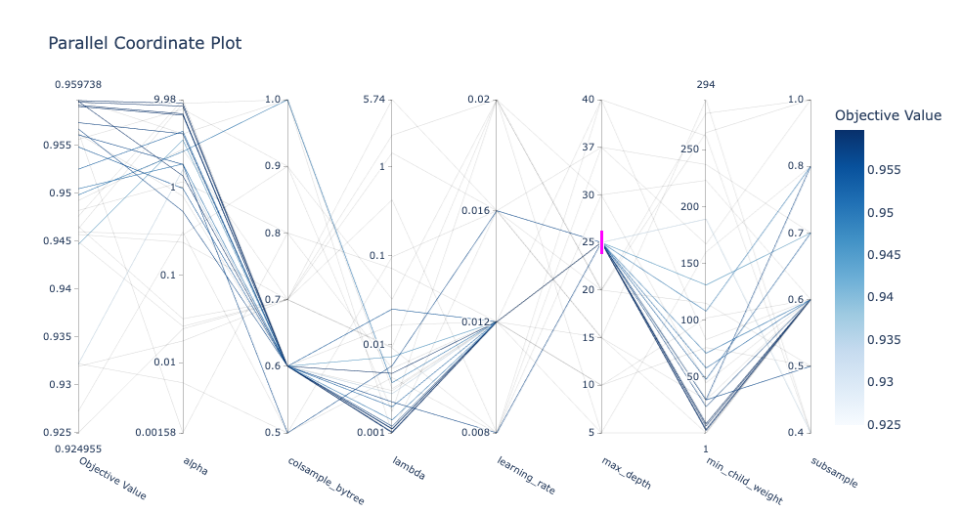
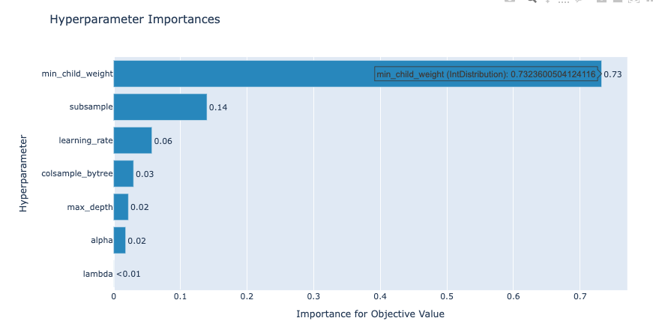
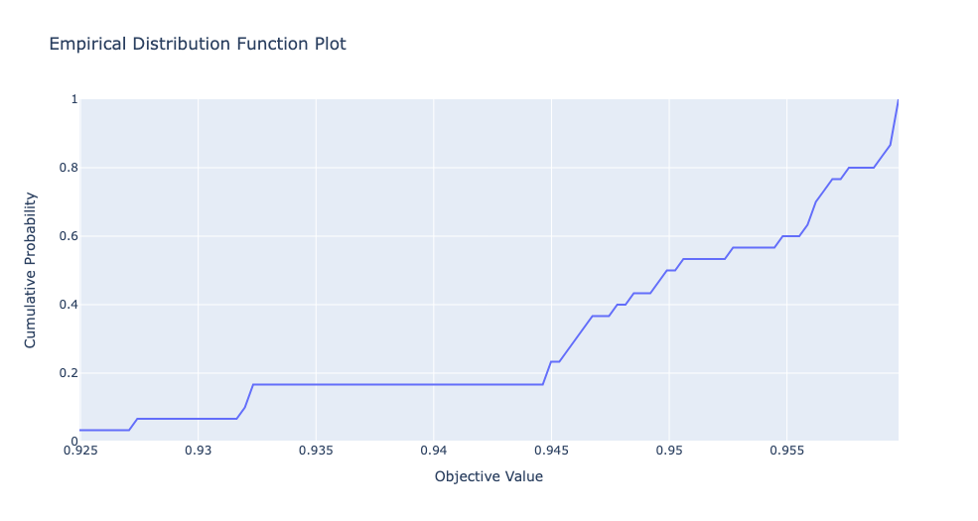
Hyperparameter Optimization
Optuna: Allows users to define the preferred range of hyperparameter & target objective before trying combinations of hyperparameters
One optimization process is called a “study”
HyperOpt: Instead of defining the search space in the objective function, HyperOpt allows us to define it using hp.choice outside of the objective function
Interactive plots produced using the visualization function in Optuna

Slide 16
Optimization Summary
 | Learning Rate | Alpha | Max Depth | Accuracy of Validation Set
Bayesian Optimization | 0.462 | 1 | 23 | 0.9597
ASHA by SHERPA | 0.773 | 24 | 127 | 0.9609
Optuna | 0.016 | 4.069 | 15 | 0.9511
HyperOpt | 0.368 | 2.147 | 10 | 0.9591

Slide 17
Explainability

Slide 18
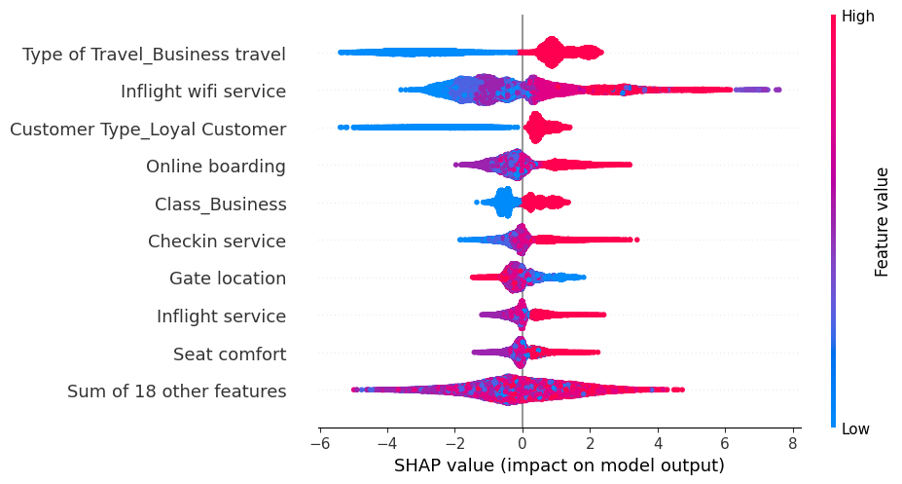
Model Explainability Using SHAP
TEMPORARY
By using Shap values to decompose the prediction into contributions from each input feature, we can gain insight into how the model is making its decisions.
Business Class travel increases the probability of a customer being satisfied
For loyal customers the probability of the customer being satisfied is higher
For Online Boarding, Business class and Checkin service the probability of a customer being satisfied is higher.
For higher values of inflight service and seat comfort, the probability of a customer being satisfied is higher.

Slide 19
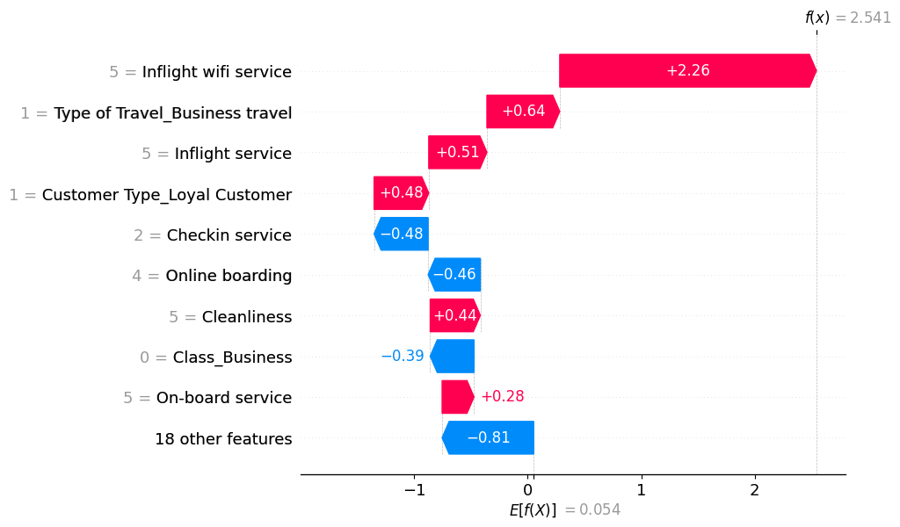
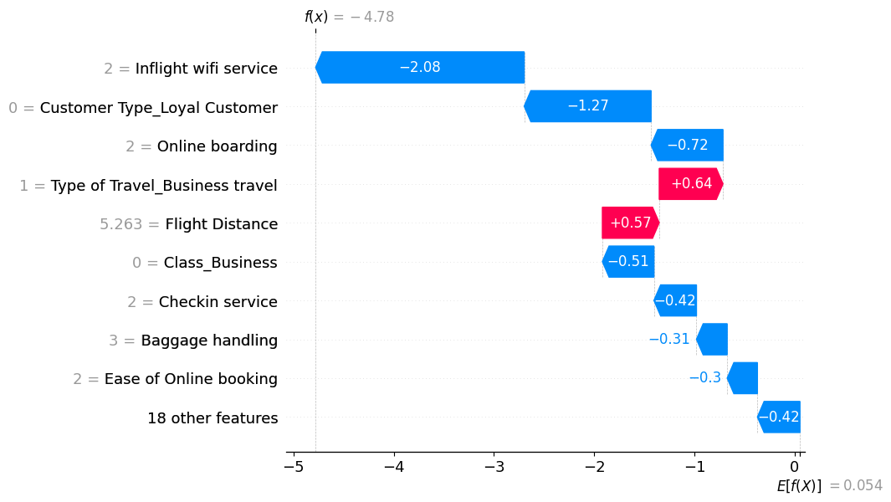
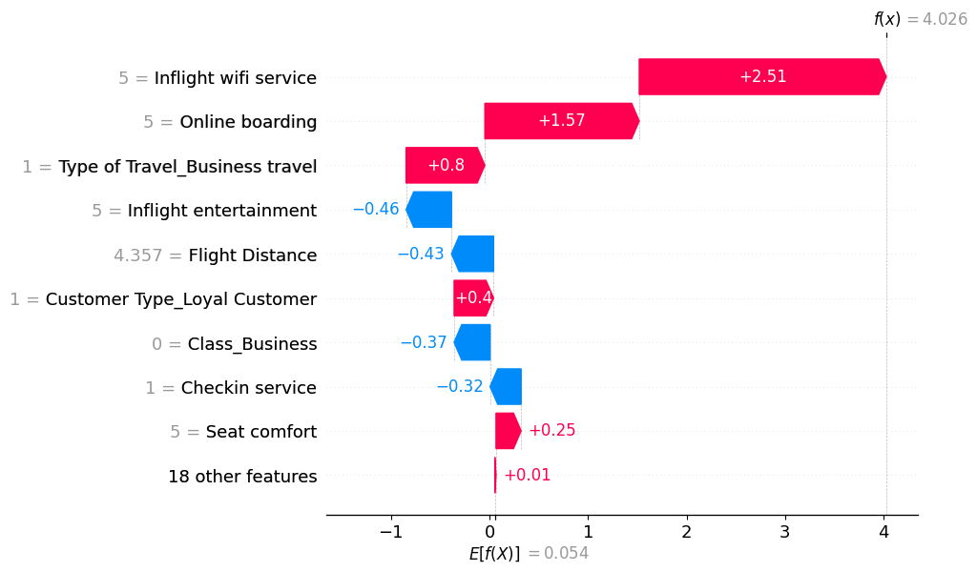
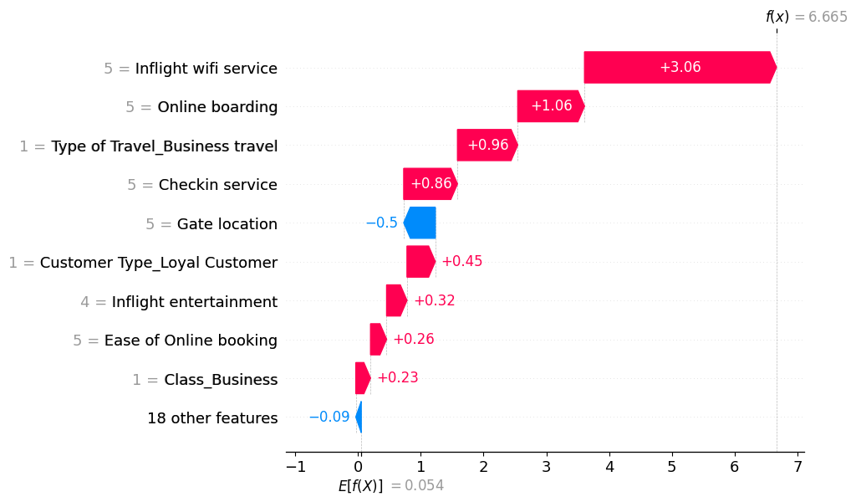
Model Explainability

Slide 20
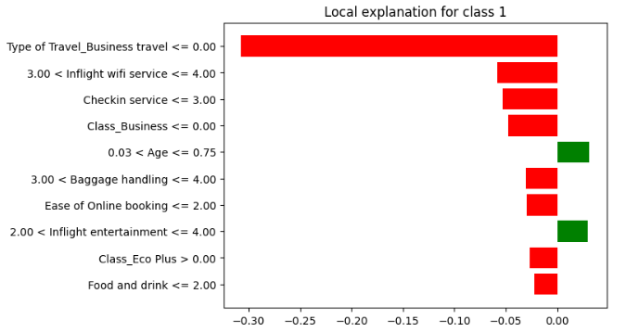
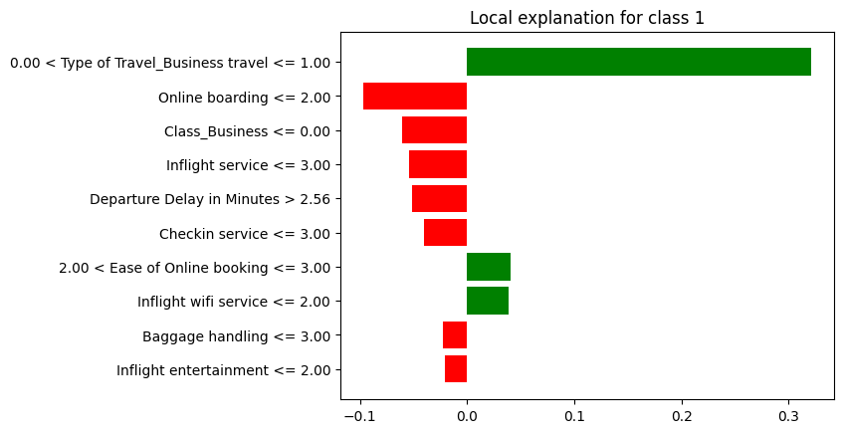
Comparison with LIME

Slide 21
Bias
PLACEHOLDER FOR UCs

Slide 22
Thank you!
Any questions?

Slide 23
Appendix

Slide 24
Project Links
Git Project - https://github.com/orgs/McGill-MMA-EnterpriseAnalytics/projects/29
Git Repository - https://github.com/McGill-MMA-EnterpriseAnalytics/Flyer_Customer_Satisfaction

